Slide 1
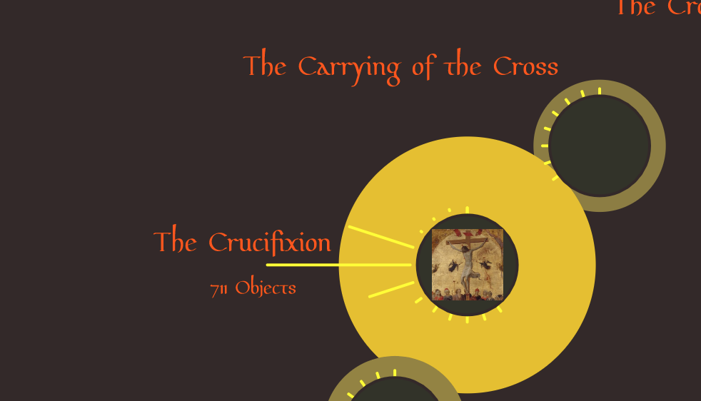
THE ROSARY; A STUDY IN CATHOLIC ART
Douglas Locke
September 23, 2019

Slide 2
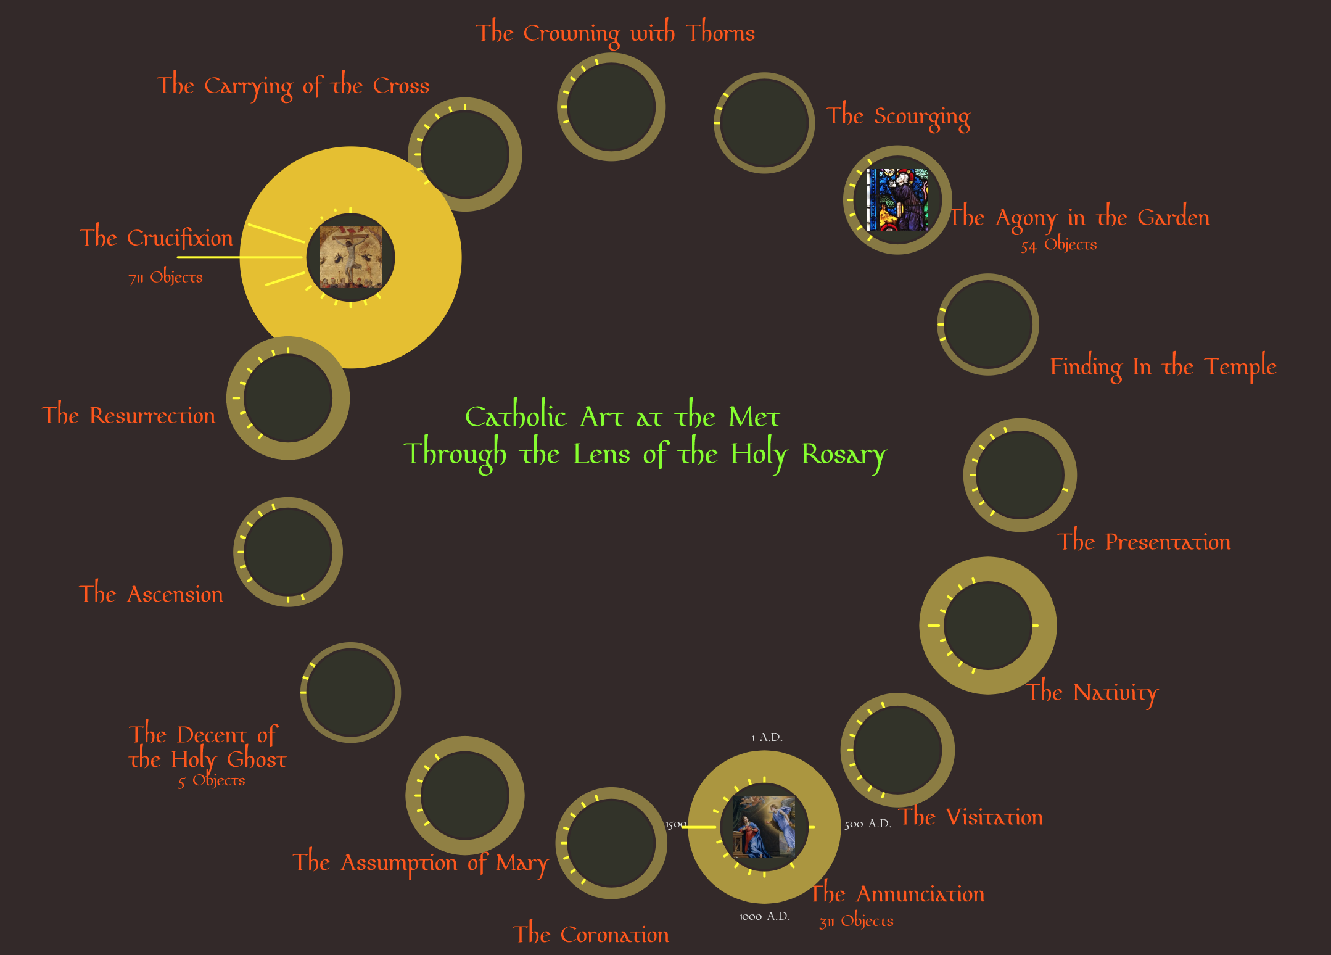

Slide 3
Concept

Slide 4
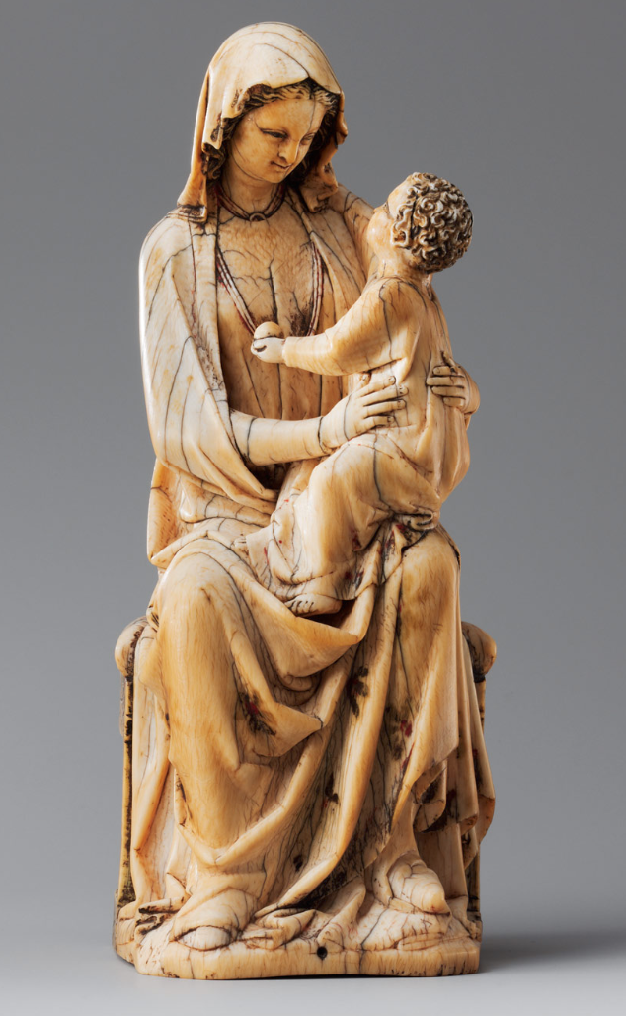
Concept

Slide 5
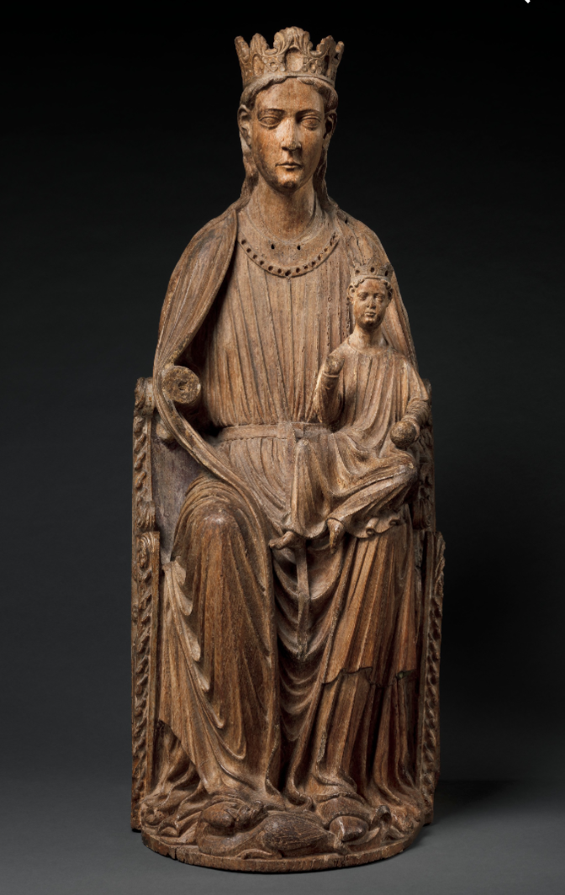
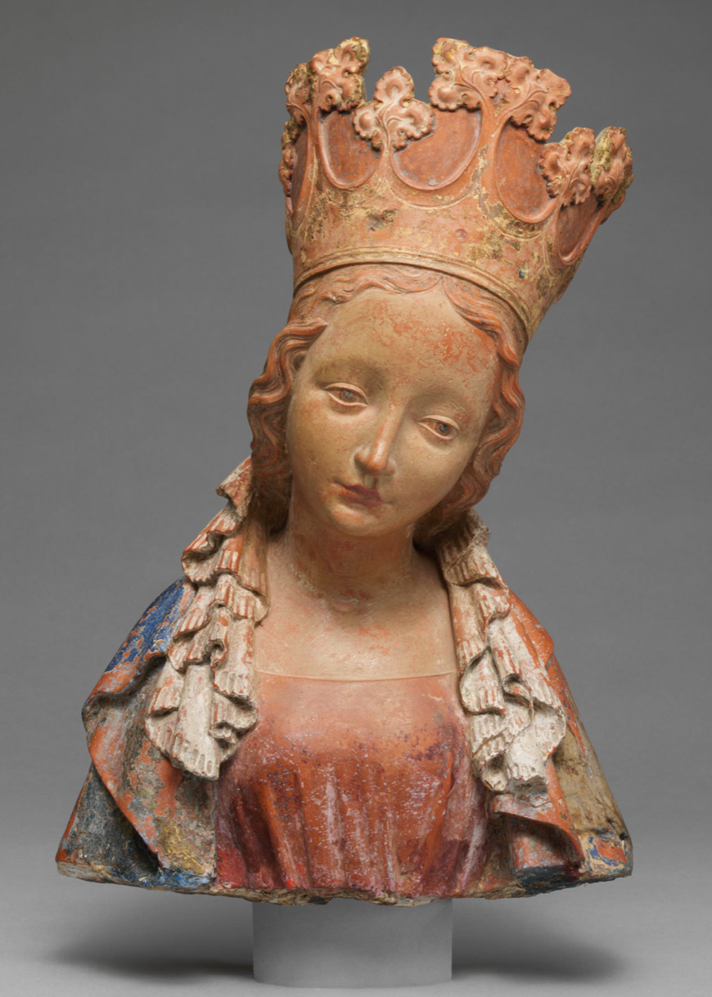
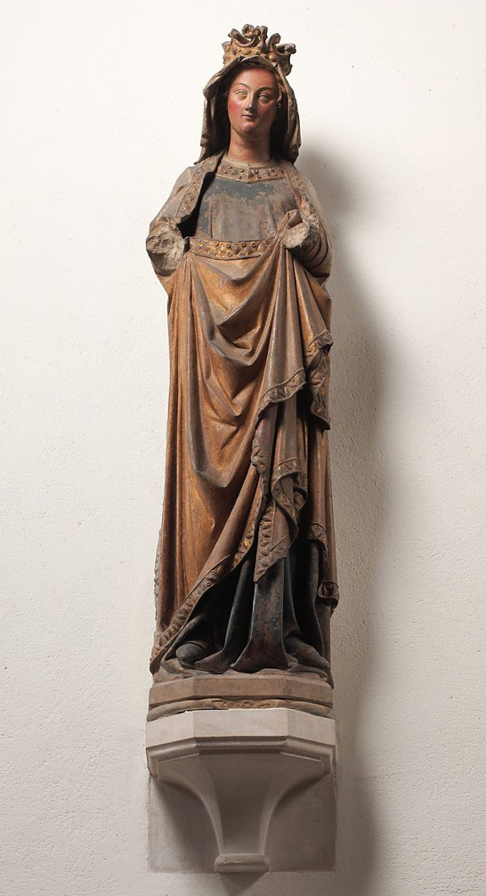
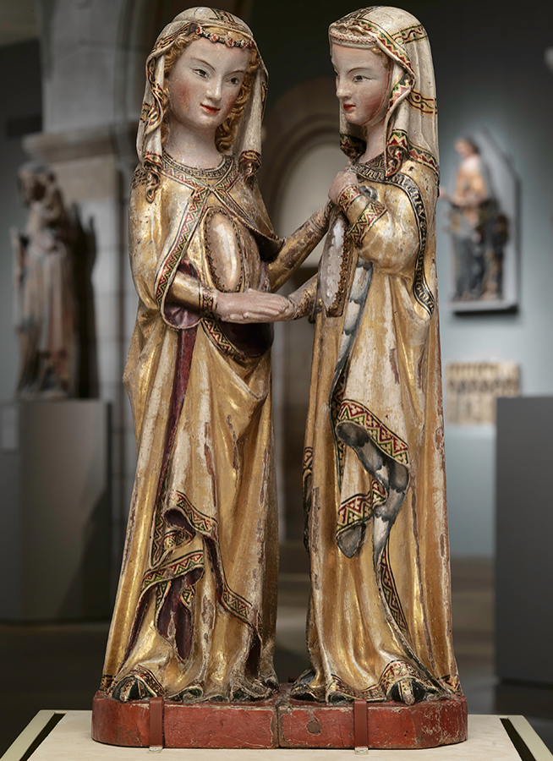
Concept

Slide 6
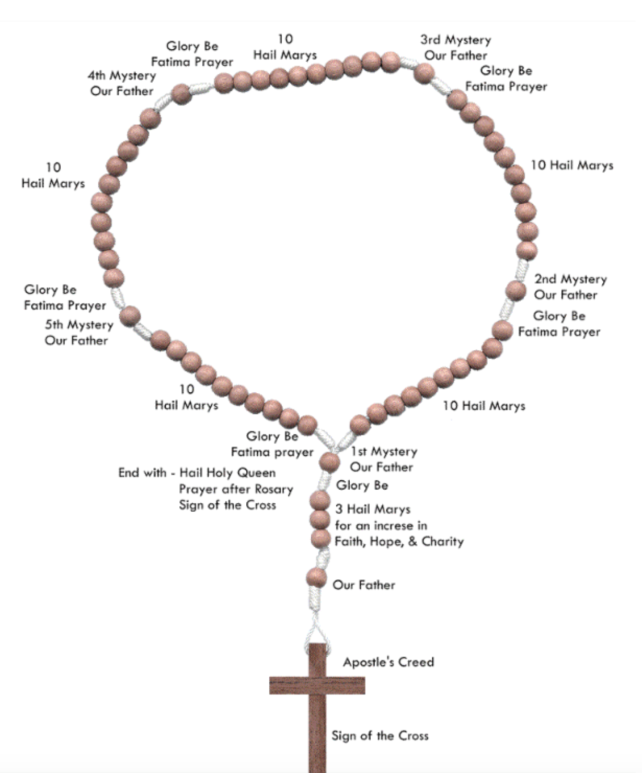
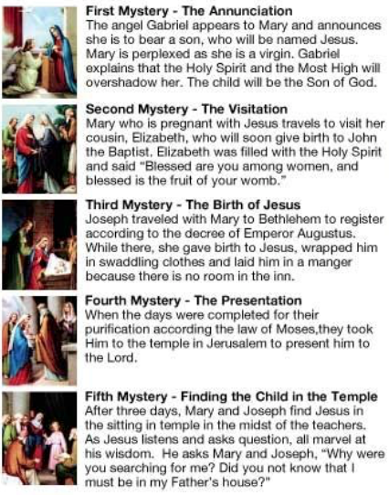
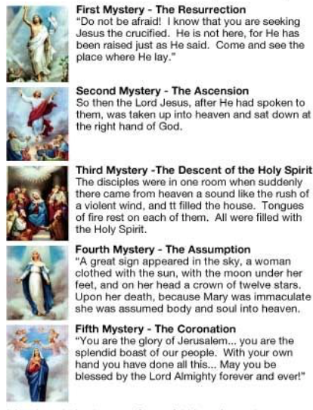
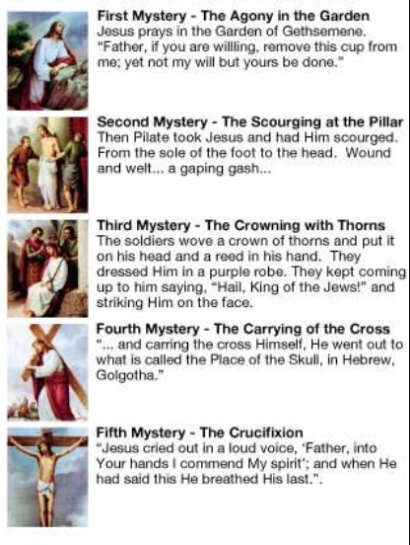
Joyful
Concept
Glorious
1
11
2
12
3
13
4
14
5
15
Sorrowful
6
7
8
9
10

Slide 7
Concept
Goals:
Explore presentation of religious art in secular museums
Reframe presentation into narrative, provides missing context
Means:
Rosary provides the frame & narrative
Find art related to each of the 15 Rosary mystery.
The Met is deep in this art
Questions:
What will we find amongst a large number of objects?
Mediums, periods, origins, etc?

Slide 8
Process

Slide 9
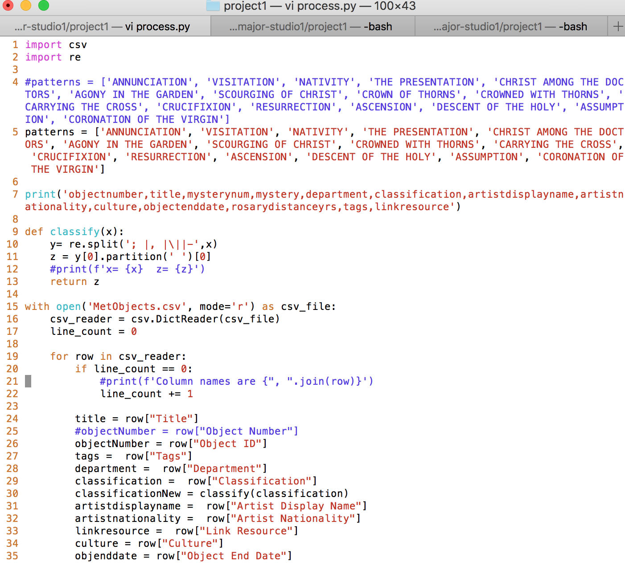
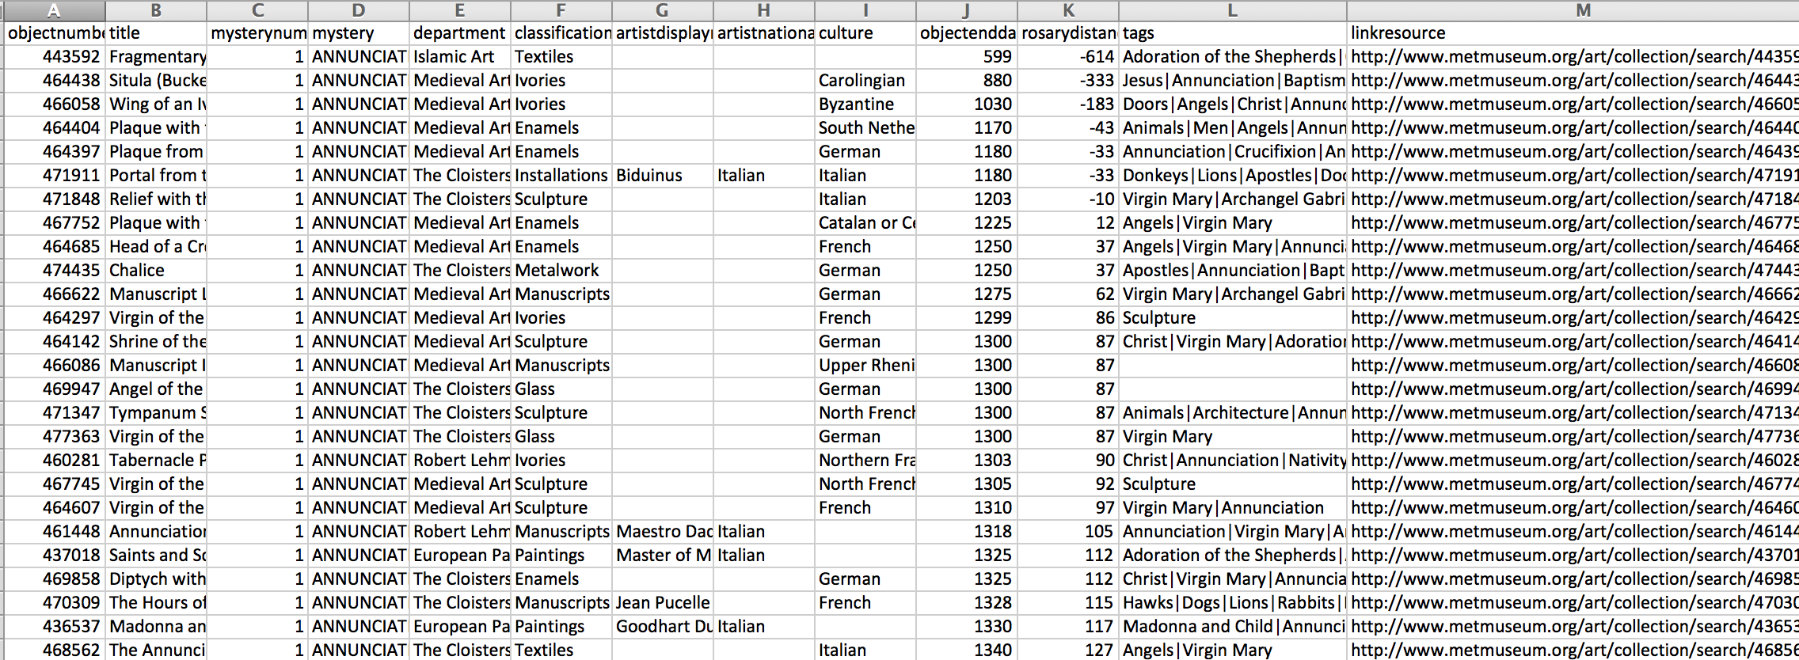
Process
Data Process:
Python script on CSV that performs text search
Result:
~2000 objects
Special Processing:
Rosary Mystery
Close to 1213 (popularization of the Rosary)
Simplification/cleanups of:
Classification
Culture (still working on this)

Slide 10
Data Analysis

Slide 11
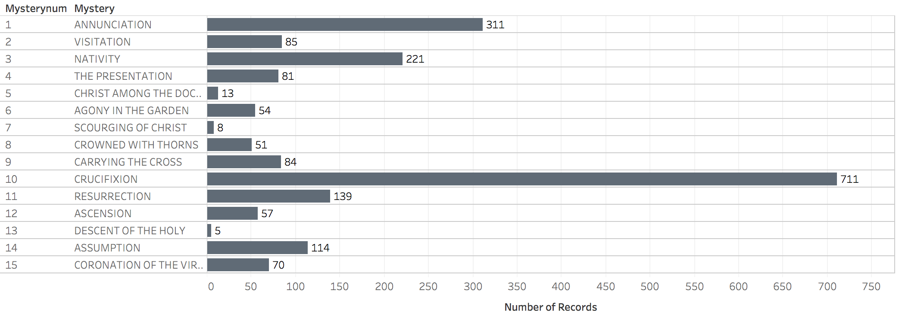
Data Analysis
All mysteries were represented with objects.
Nativity (Christmas) & Crucifixion were most frequent.
Annunciation, Assumption, Visitation were surprisingly frequent.

Slide 12
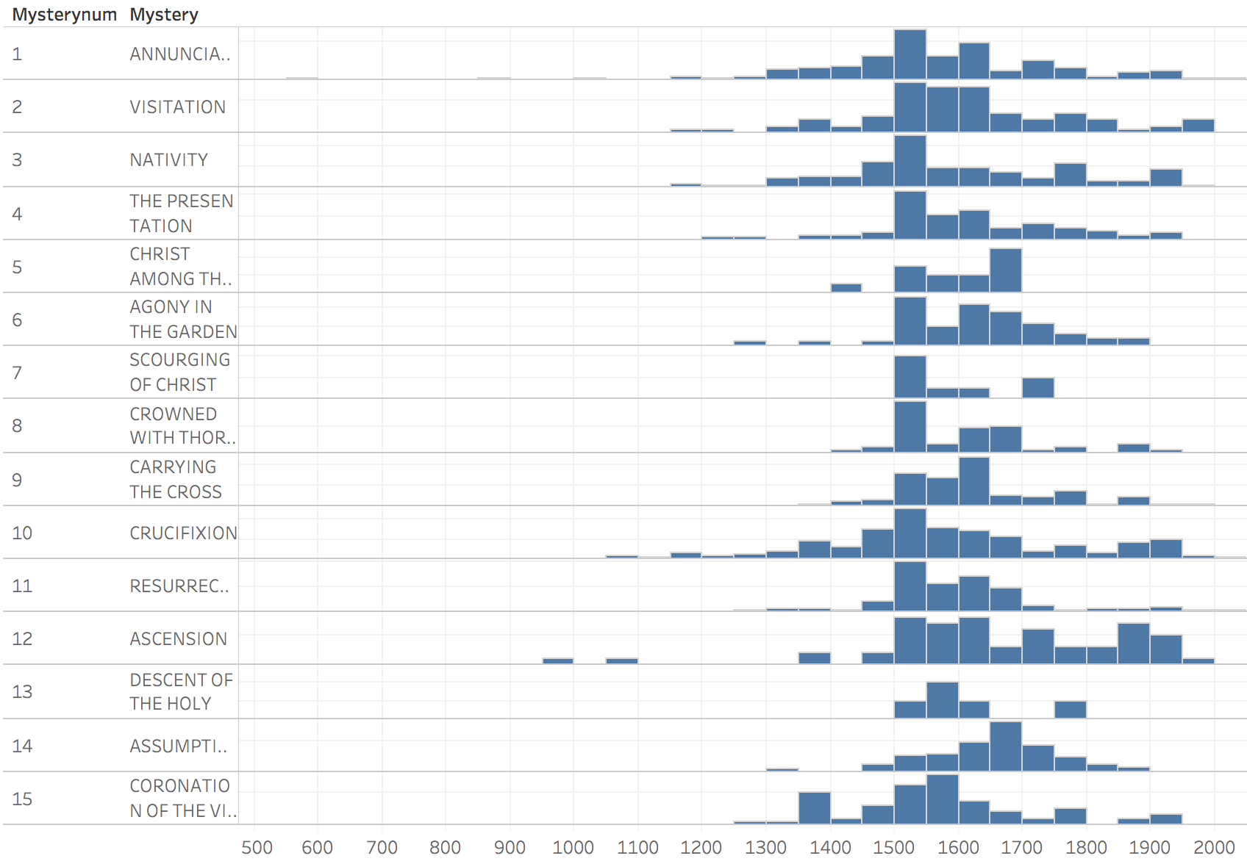
Data Analysis
St. Dominic & rosary popularization
Object Creation Year

Slide 13
Data Analysis
Oldest object department is in Islamic Art
Most recent as of 2005
Modern/secular(?) art
St. Dominic & rosary popularization
Sustained interest
Into 20th century?
Declining interest?
Sustained interest
Into 20th century?
Object Creation Year

Slide 14
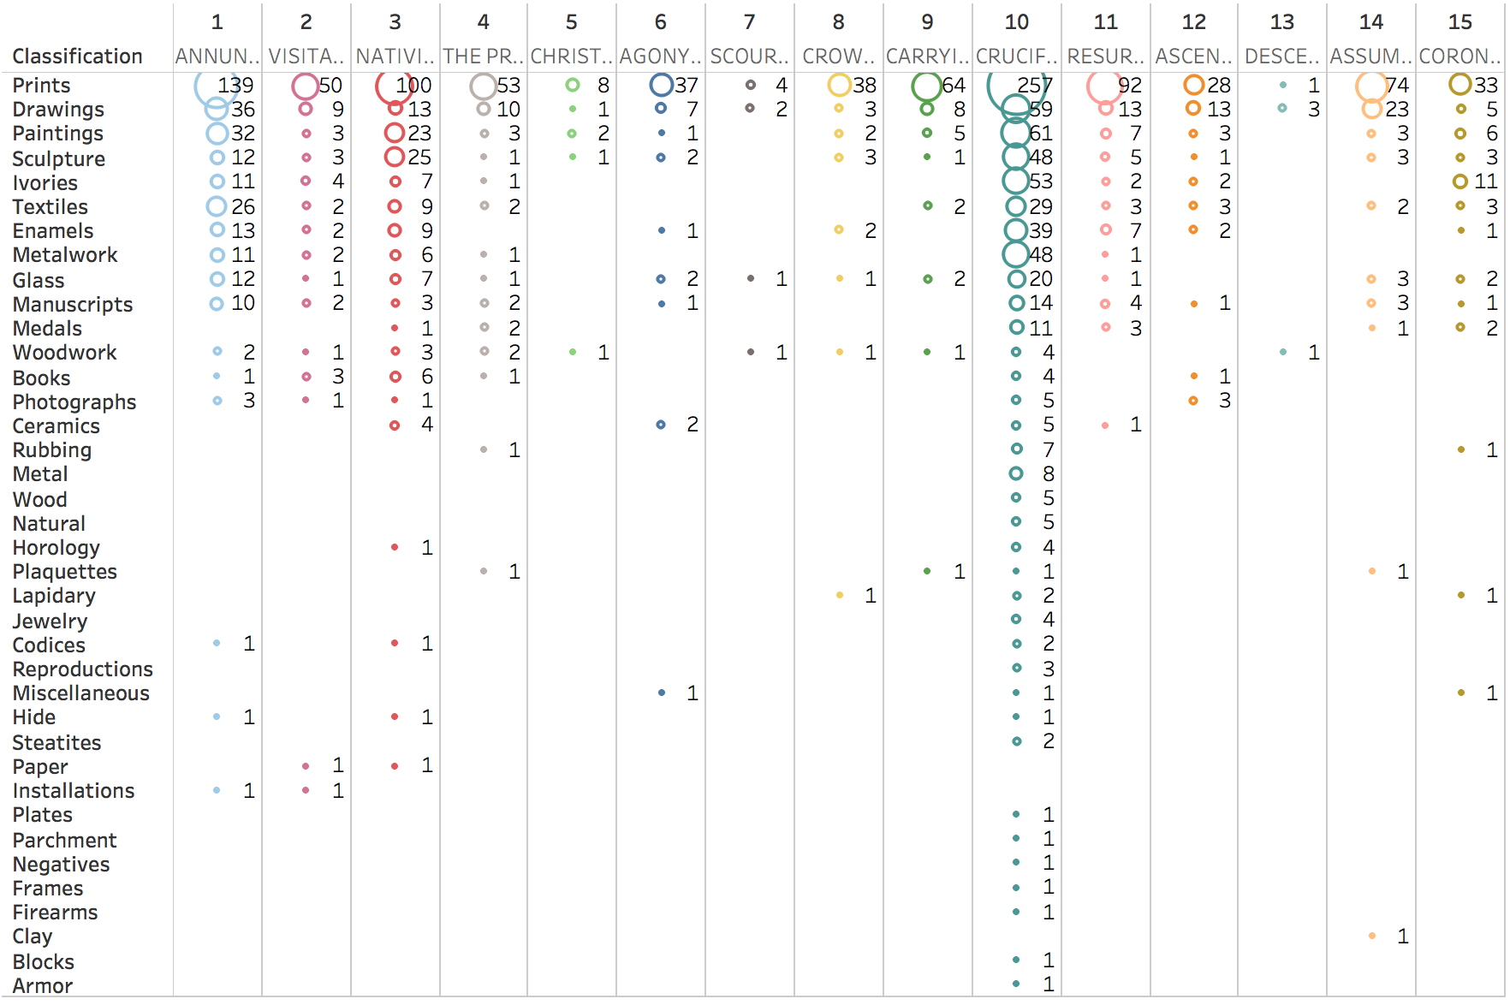
Data Analysis
Classification

Slide 15
Data Analysis
Data Elements
Aggregates
Count of objects by Mystery
Diversity of objects, e.g. the number of different classifications
Max by Culture (e.g. Italian, German)

Slide 16
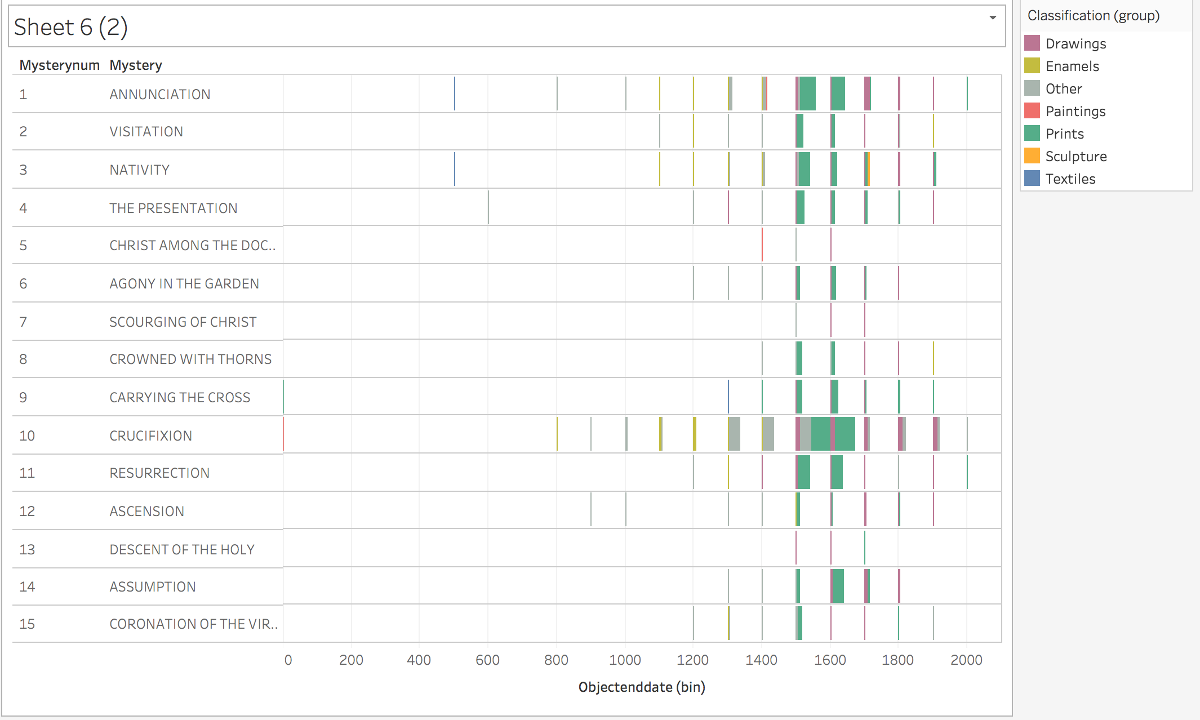
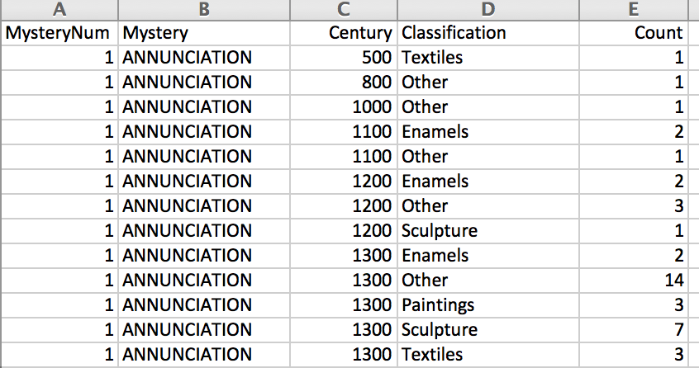
Data Analysis

Slide 17
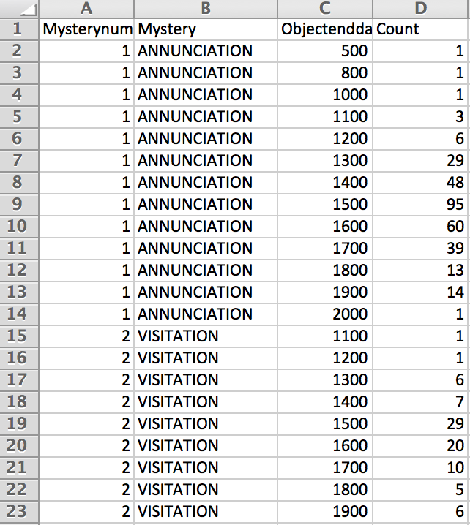
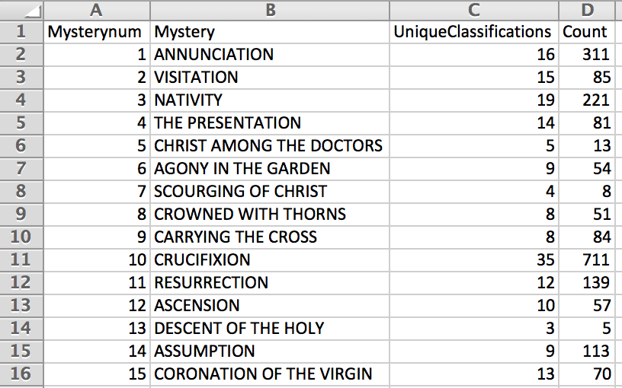
Data Analysis
FINAL DATA FILES: 2 CSVs
SUMMARY
DETAILS

Slide 18
Design

Slide 19
Design

Slide 20
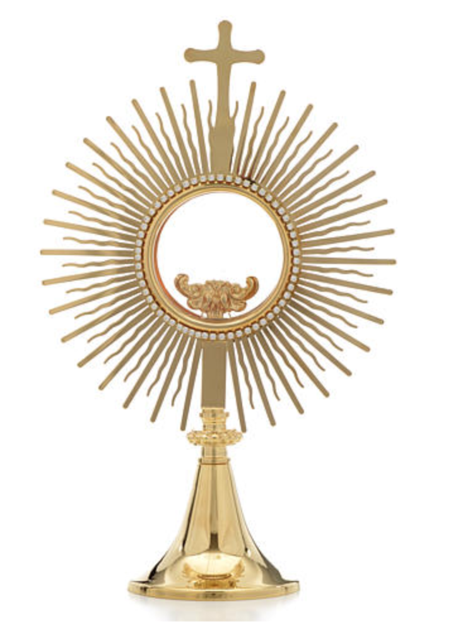
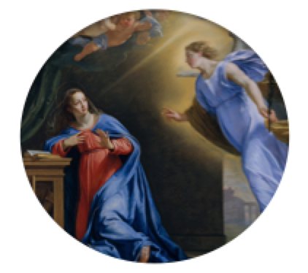
Design

Slide 21
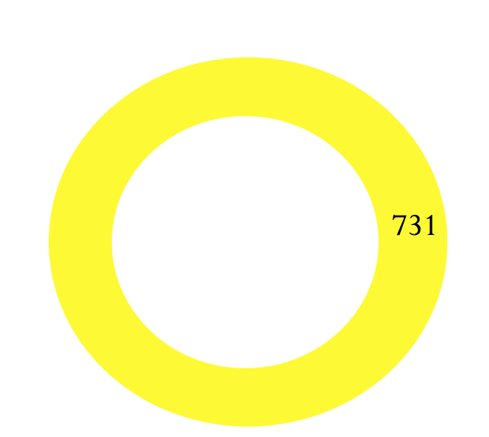
Design
The Annunciation

Slide 22
Design
Paintings
Drawings & Prints
Sculpture
Others
0
2019
The Annunciation

Slide 23
Design
Paintings
Drawings & Prints
Sculpture
Others
0
2019
The Annunciation
Integration of culture/origin country?
Top culture?
More aggregated view
Integration of interesting details (mouse over?)

Slide 25
Typeface
Pffeffer Mediaeval
THE ROSARY; A STUDY IN CATHOLIC ART
Perpetua
THE ROSARY; A STUDY IN CATHOLIC ART

Slide 27
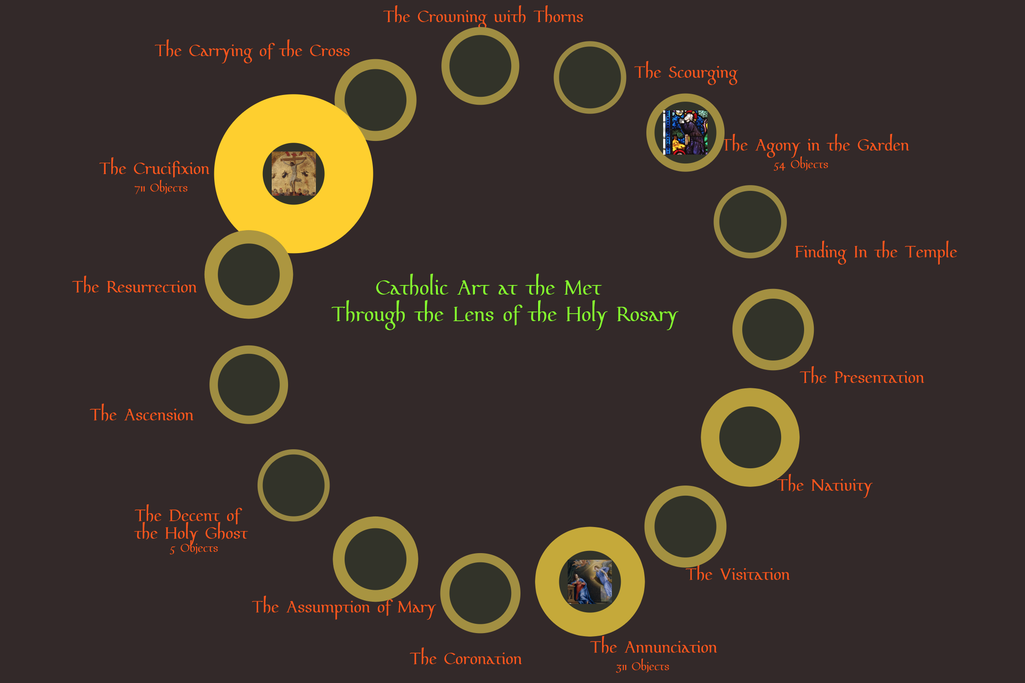

Slide 28
End

